Slide 1

MKTG 562 Customer Analytics
Paid Search for Hotels Online Reservation
Anamika, Snehal, Shrija,
Nissim, John,Mustafa
Michael G. Foster School of Business | University of Washington | Seattle, WA
Notes:
SARAH:
Thank you and welcome.
Introductions
We are Team Bond, Treasury Bond from the University of Washington School of Business.
In 10 years, you have brought this company so far, this innovative pathway that’s holds the promise to potentially to effect change in the lives of millions. In this time you’ve come so far, raising substantial capital and progressing your research to see the diverse set of potential applications for both the delivery system and synfusion therapies.
And now you have an acquisition offer from a major pharmaceutical company, you’ve asked us to advise you on two questions:

Slide 2

Dataset Description
~8,500 data points of hotels ads during April 2004
Keywords searched (Branded vs. Generic)
# of Impressions
# of Clicks
ad Cost
Geographic locations
Ad average position
13 of 15

Slide 3
Project Objectives?
What factors drives # of online reservations?
Clicks
What factors drive the # of clicks?
Average Position
Impressions
2 of 15

Slide 4
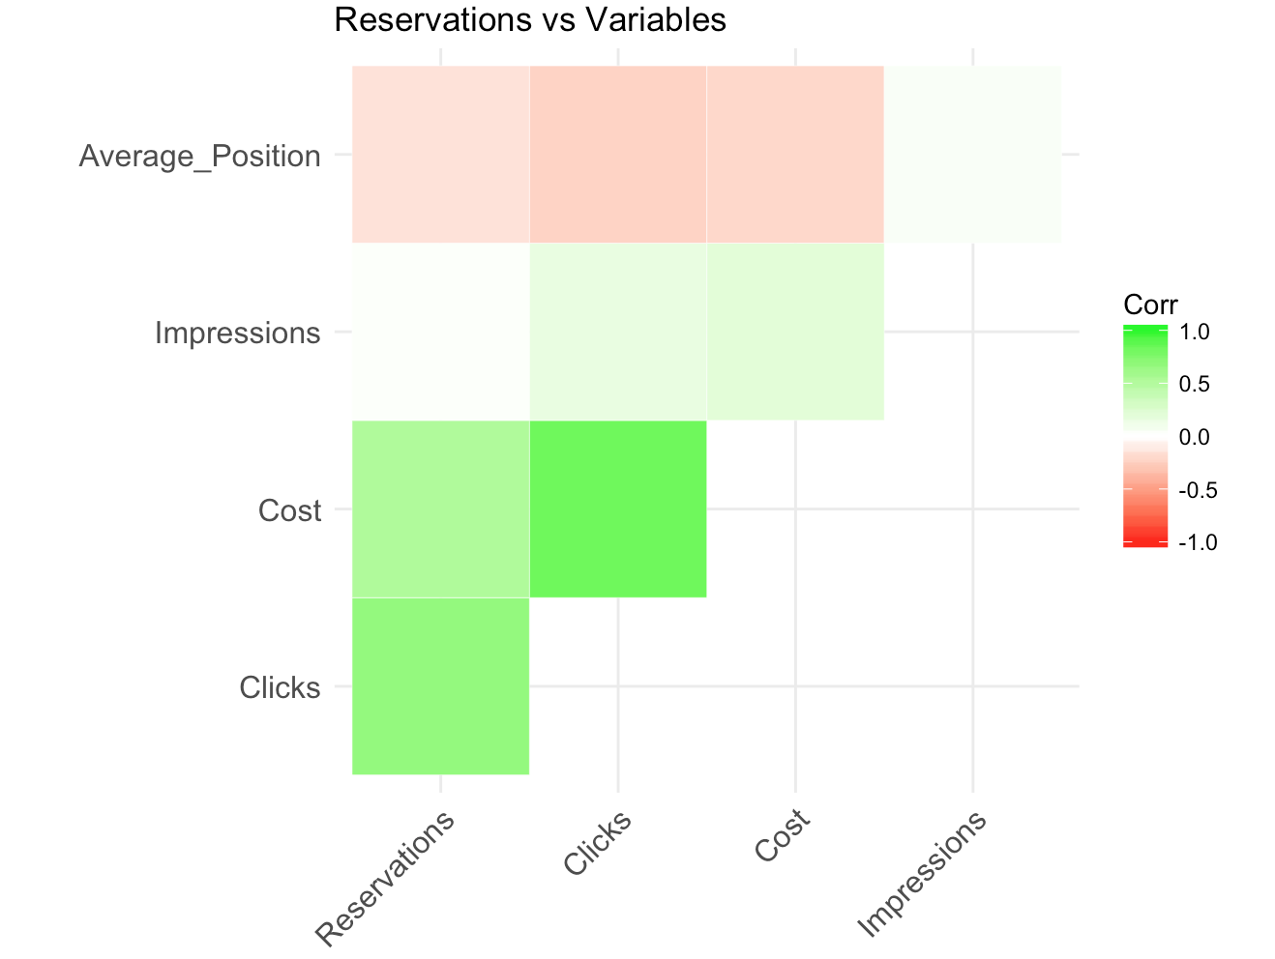
Data Analytics - Correlation
Reservations | 1.00
Avg. Position | -0.15
Impressions | 0.02
Clicks | 0.66
Cost | 0.51
Page | -0.04
13 of 15

Slide 5
Data Analysis
More than 25 models are created to analyze existing online reservation data
Linear Models
Concave Quadratic Models
Linear log Models
Carryover Models
Binary Logit (GLM)
13 of 15
Notes:
John

Slide 6
Online Reservation Model
Online Reservation models resulted in R squared values up to 0.467
R squared of 0.467:
Reservations = 0.018 + (0.015 * Clicks (2) )
13 of 15
Notes:
John
Only factor is Clicks ^2
Higher R2 by adding cost but there is high correlation between the two so not as much value add.

Slide 7
Clicks Regression Model
R squared of 0.47:
Clicks = 3.43 – 3.23* log (average position)+ 0.93* Log(impression)
13 of 15

Slide 8
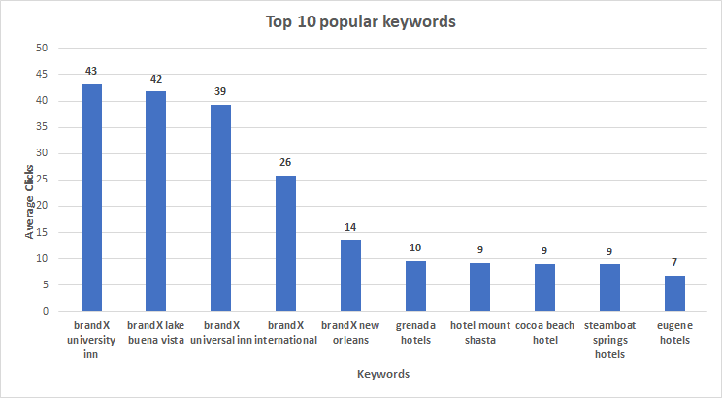
Popular Keywords
13 of 15
Notes:
Mustafa: We can see here the most popular keywords based on the average # of clicks

Slide 9
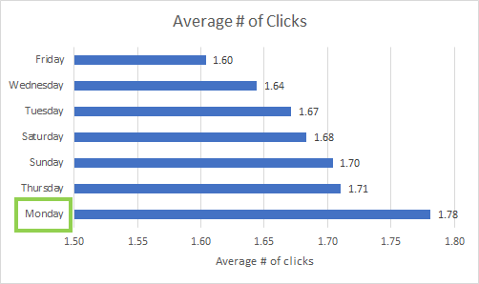
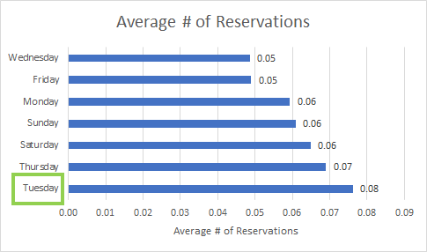
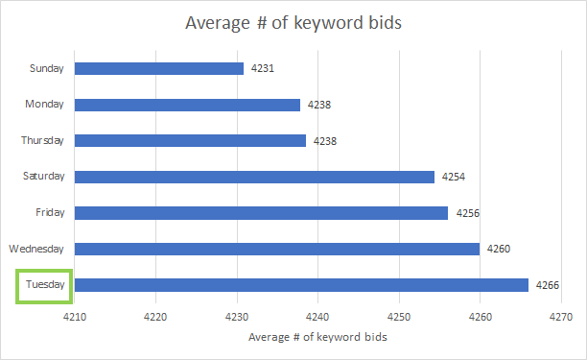
Day of the Week Trends
13 of 15
Notes:
People mostly look around and book during Monday and Tuesdays
Good cost optimization: We are bidding less on the days when we are receiving highest number of clicks

Slide 10
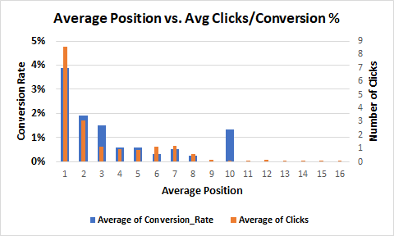
Ave. Position vs. Clicks & Conversion %
13 of 15
Notes:
AJDIN
adding sensitivity graph
financial multiples (accounting ratios) for syntonix not available we’re limited to the information in the case e.g. employees no. ect
spread from success to failure very large

Slide 11
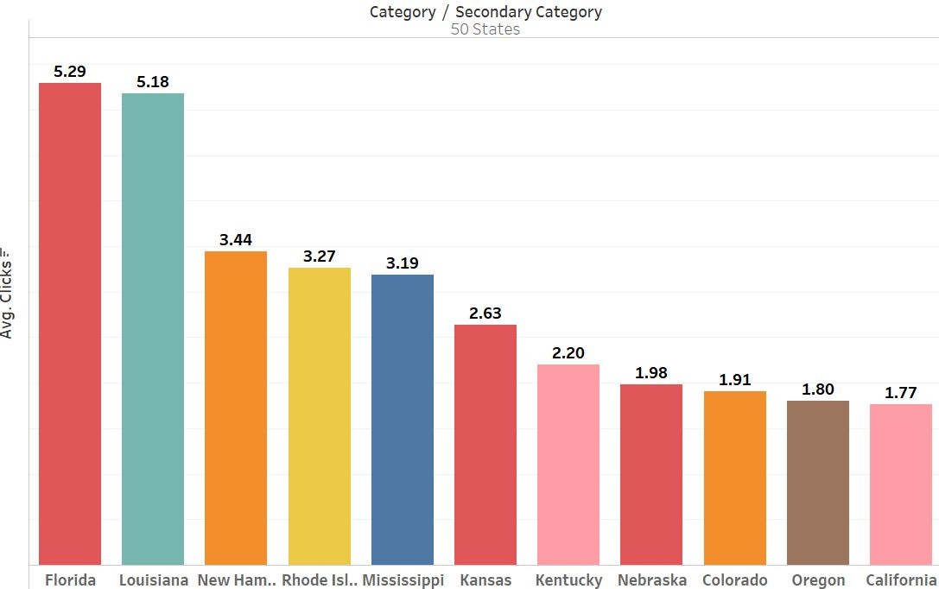
Top States vs. Avg Clicks
13 of 15
Notes:
If we see secondary category ’50 States’, we can analyze hotel keywords belong to what state and their corresponding measures such as clicks and CTR. We created a bar plot of these keywords by sum of their respective clicks. It shows that keywords belonging to hotels in Florida are receiving highest clicks on an average.

Slide 12
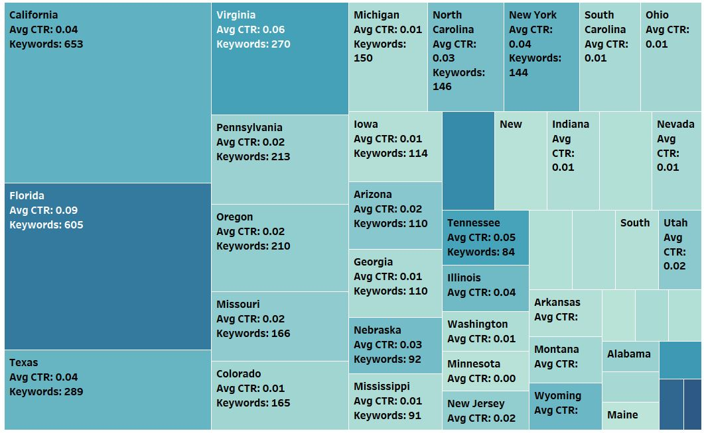
Avg CTR for Keywords for 50 States
13 of 15
Notes:
In the heat map, color of a rectangle denotes average CTR and size of rectangle denotes count of keywords. So, larger a rectangle, higher the count of keywords for that category and darker the shade of color, higher the average CPR.
1. For further analysis, we built a heat map for secondary category ’50 States’ for measures average CTR and count of keywords. As seen from the heat map, California has a higher count of hotel keyword occurrences than Florida, but keywords in Florida have a higher CTR on an average. We think this is because Florida is seen as more of a tourist destination than California. People might be researching hotels in Florida more as they prepare for a summer vacation over the next quarter.
adding sensitivity graph
financial multiples (accounting ratios) for syntonix not available we’re limited to the information in the case e.g. employees no. ect
spread from success to failure very large

Slide 13
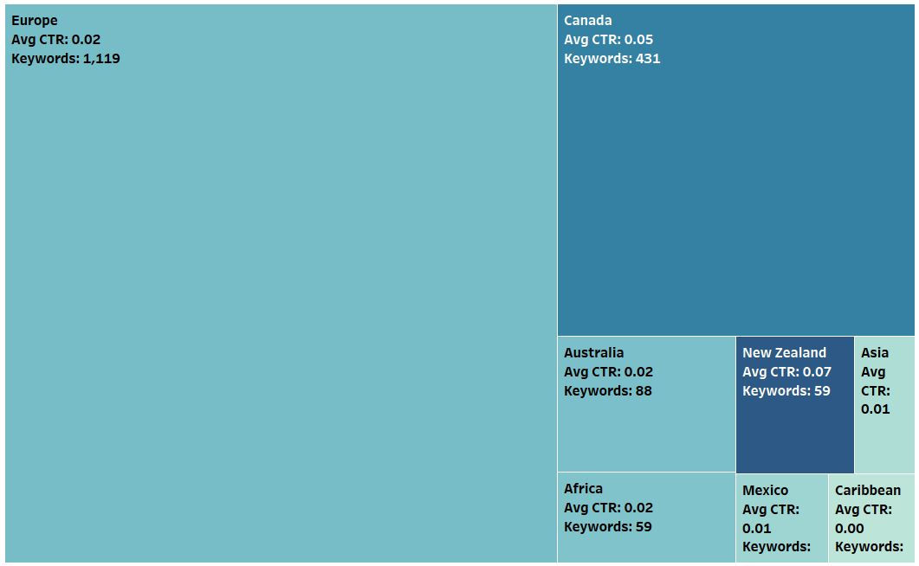
Avg CTR for Keywords in International Category
13 of 15
Notes:
Similarly, we created a heat map for secondary category ‘International’. Keywords belonging to hotels in New Zealand have a higher CTR on average compared to other regions. Even though hotels in Europe have a really high occurrence at 1,119 keywords over the entire month, its average CTR is lower to many other regions such as New Zealand and Canada.

Slide 14
Analysis of keywords for ‘Europe’
Keyword | Impressions | Clicks | CTR
london cheap hotels | 11,325 | 19 | 0.001
innsbruck hotel | 13,417 | 34 | 0.002
gent hotel | 11,138 | 37 | 0.003
dortmund hotel | 3009 | 10 | 0.003
canterbury hotel | 2134 | 10 | 0.004
13 of 15
Notes:
To analyze why Europe had high number of keywords but lower CTR compared to other regions, we analyzed keywords specific to Europe. Since average CTR for these keywords is not proportional to the number of keywords, it seemed that some keywords had high impressions but low clicks. So these are the top 5 words with low CTR. For example, “london cheap hotels” had almost one click per thousand impressions. Since these keywords are shown to searchers but they are not getting as many clicks, we think that the content of the ads is not good or the ads don’t look good enough to attract clicks.

Slide 15
Keyword Type Analysis
Keyword Type | Total Keywords | Total Clicks | Total Reservations | Average Conversion Rate
Generic | 201 | 6011 | 100 | 0.56%
Branded | 100 | 8293 | 418 | 1.77%
Generic → 158 keywords with 0 reservations (~78.6%)
Branded →59 keywords with 0 reservations (59%)
Generic → Maximum number of reservations made for a keyword is 4
Branded → Maximum number of reservations made for a keyword is 10
1/3rd of the keywords are “Branded” type but have 3 times the average conversion rate.
Branded keywords have over 4 times the number of total reservations
13 of 15
Notes:
3x conversion rate for branded vs generic - branded searches means customer knows what they want

Slide 16
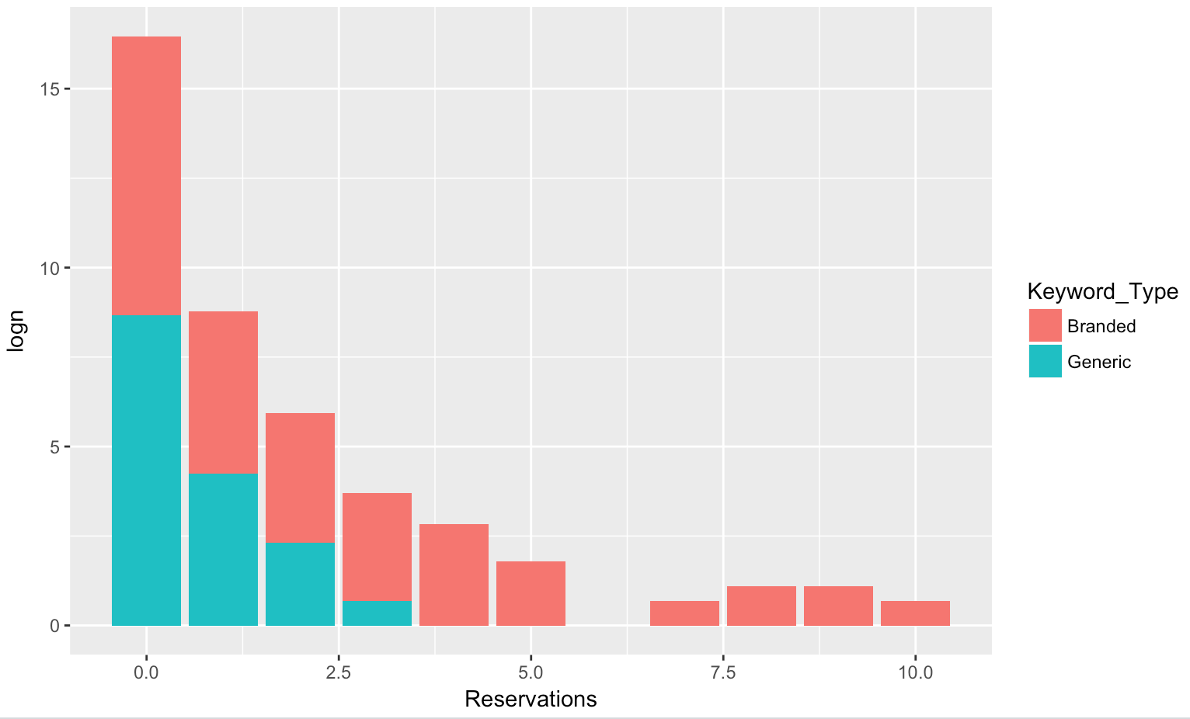
Keyword Type Analysis
log of # of datarows
13 of 15
Notes:
AJDIN
adding sensitivity graph
financial multiples (accounting ratios) for syntonix not available we’re limited to the information in the case e.g. employees no. ect
spread from success to failure very large

Slide 17
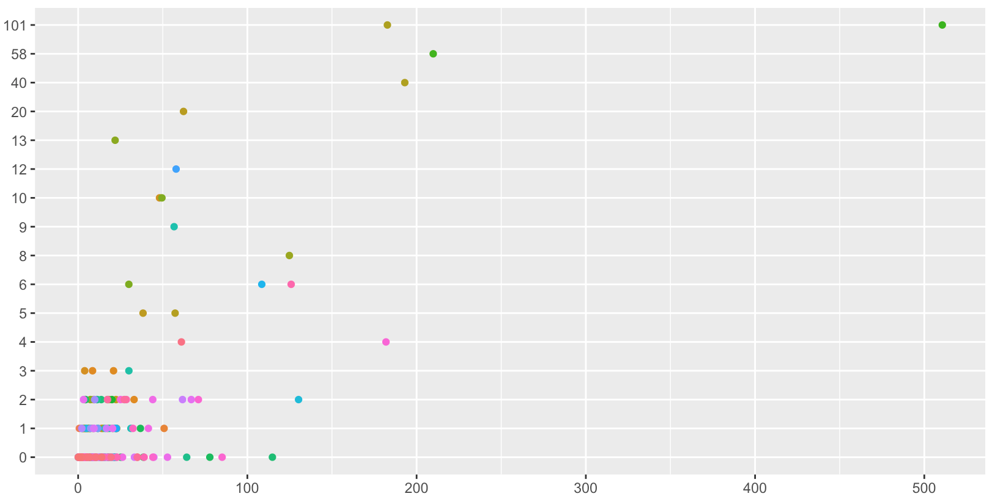
Revenue Analysis
Total Cost VS Total Number of Reservations
Reservations
Cost
13 of 15

Slide 18
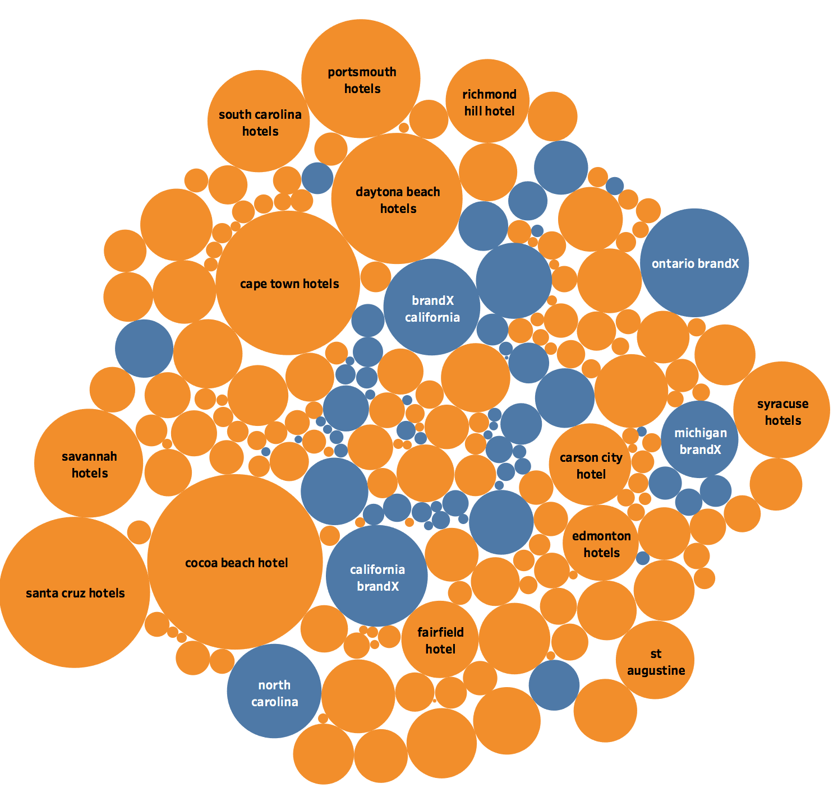
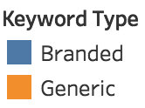
Cost of Clicks Analysis
13 of 15
Notes:
217 keywords with 0 revenue
cocoa beach hotel -> 273 Clicks and 114.8 cost
there were many branded keywords in here as well

Slide 19
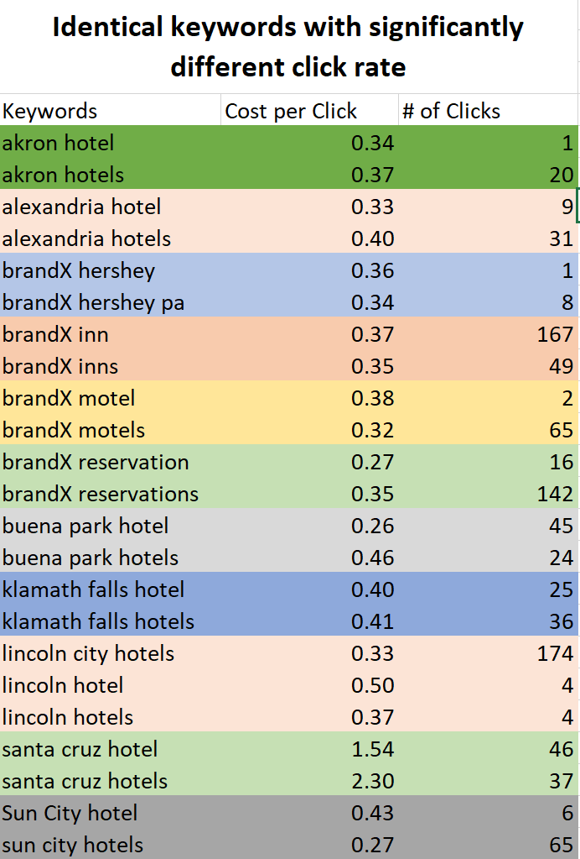
Areas of Opportunity
Bidding on almost similar keywords should be optimized
Although no regression model explained the average position data behavior, securing higher positions leads to higher number of clicks and conversion rates
It might be beneficial to review the 217 keywords that are costing money and generating no revenue (specially branded ones, as they are supposed to perform better).
13 of 15
Notes:
analyze if there is any value in keeping two sets of keywords
Keywords with high number of clicks but no reservations should be reconsidered? (if thats the case most days of the month) (217 such cases)

